Slide 1
GREETING!!! University Enrollment System Group 1 >>

Slide 2
Dr.Hnin Ei Latt(Supervisor)
No. | Members | Roll_No
1. | MA AYE NYEIN NANDAR BO | 5IT-2
2. | MA THAW THAW WAI | 5IT-3
3. | MA WIN THEINGI | 5IT-5
4. | MA PHWAY ZON ZAR MON | 5IT-6
5. | MA YAMIN THWE | 5IT-7
6. | MA NAW HTEE MOO WAH | 5IT-15
7. | MA HMU PYAE SHAN | 5IT-16
8. | MA APAR | 5IT-33
9. | MA SOE YADANAR HTUN | 5IT-34
10. | MG HEIN YE KYAW | 5IT-44

Slide 3
Outline
Abstract
Introduction
Aim
Advantages
Software components
System flow
Application flow
Further Extension
Conclusion

Slide 4
Abstract
Use Java,Xml and realtime database to create the android application: University Enrollment System
This android application is developed for students who want to enroll the related classes from anywhere at anytime.
There are 2 application site:Admin and User
Application of User included two categories:Announcement and Enrollment.
In the Admin:Major list,Register,Post,Select Major

Slide 5
Introduction
Nowadays internet serves as an important role in our society.
As the technology develop,we are trying to create and use the software for some of the complex process of our life.
University enrollment system software will be indeed useful for us.
Can know the activities of our university by this software.

Slide 6
Aim
To enroll much easier and faster from anywhere at anytime.
To connect between student and activities of university.
To share the up to date information from this applications.

Slide 7
Advantages
This is easy to use efficiently like an android application.
This application can reduce the waste of papers,student’s times and transportation cost.
That can inform students about various events and activities instead of sending them notices or letters.
Additionally,parents looking into to enroll their children in university can do it proficiently from home by visiting the university online enrollment forms,as previously was the case.

Slide 8


Software Component

Slide 9
Android Studio
Official IDE for Google’s Android System
Replacement for the Eclipse Android Development Tools(ADT)
Specially Designed for Android development
Java,Kotlin and C++ (+) XML
Linux,macOS,Windows

Slide 10
Firebase
Mobile and web application development platform
Cloud messaging,cloud storage,realtime database,authentication,hosting and many other services

Slide 11
System Flow(Admin)
Admin
Post
Manage Enrollment

Slide 12
System Flow(User)
Start
Announcement
Enrollment
First year
Other year
No
OTP
QR
No
Yes
Yes
Reg Form

Slide 13
System Flow(User)
Reg
Form
Generate
QR
Receipt
End

Slide 14
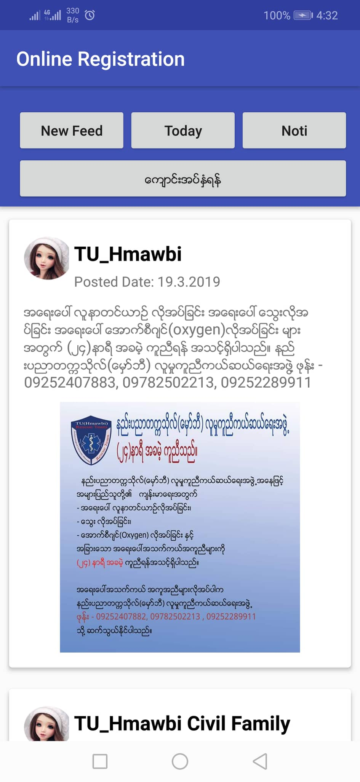
Application Flow(User)

Slide 15
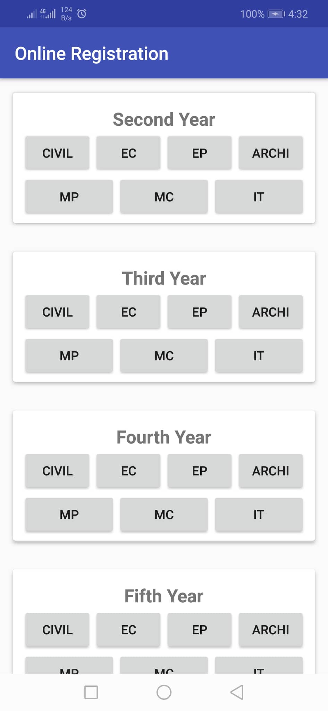
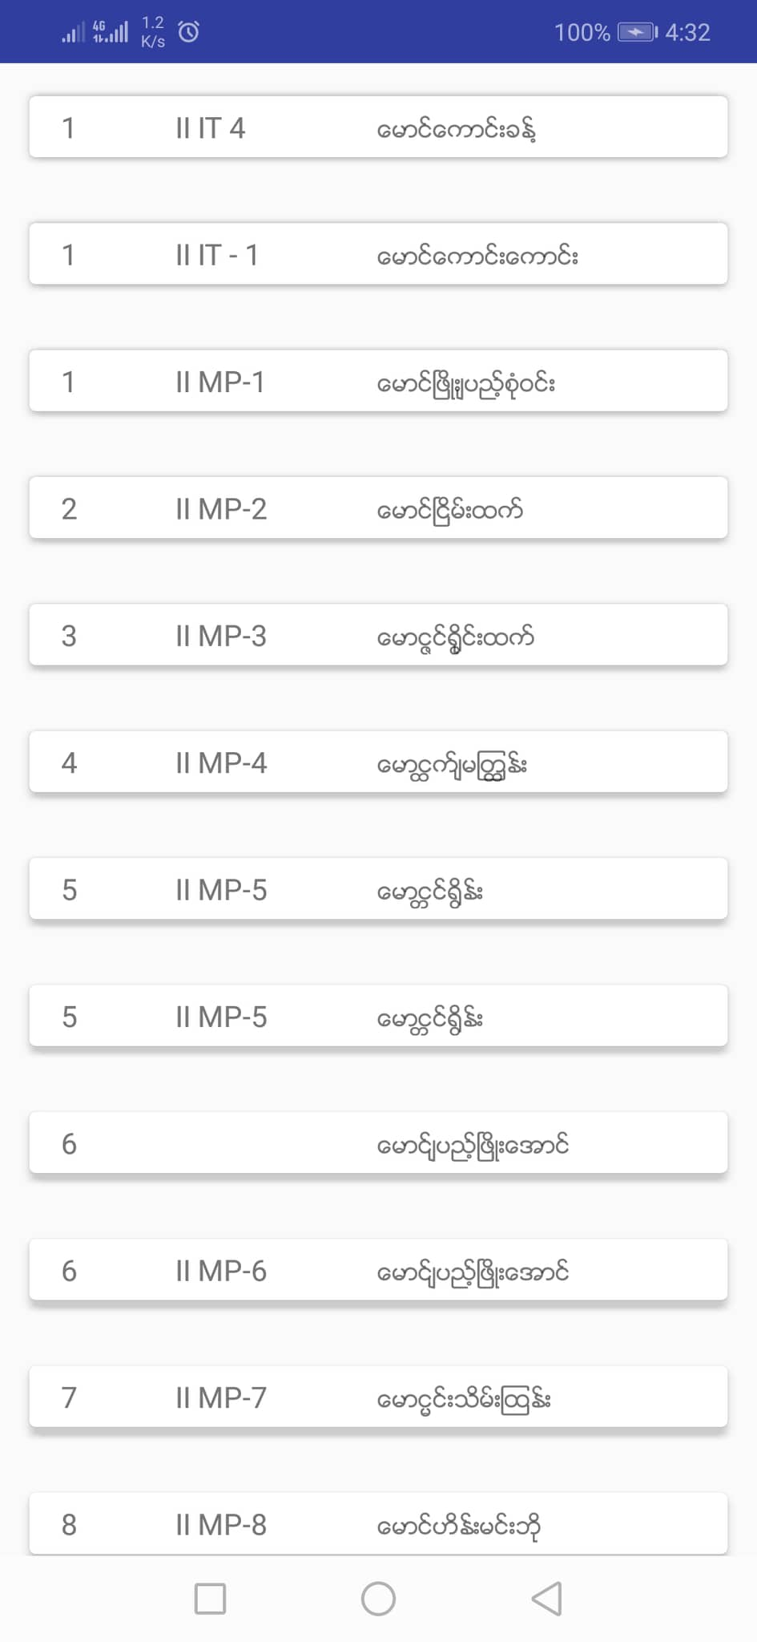

Slide 16
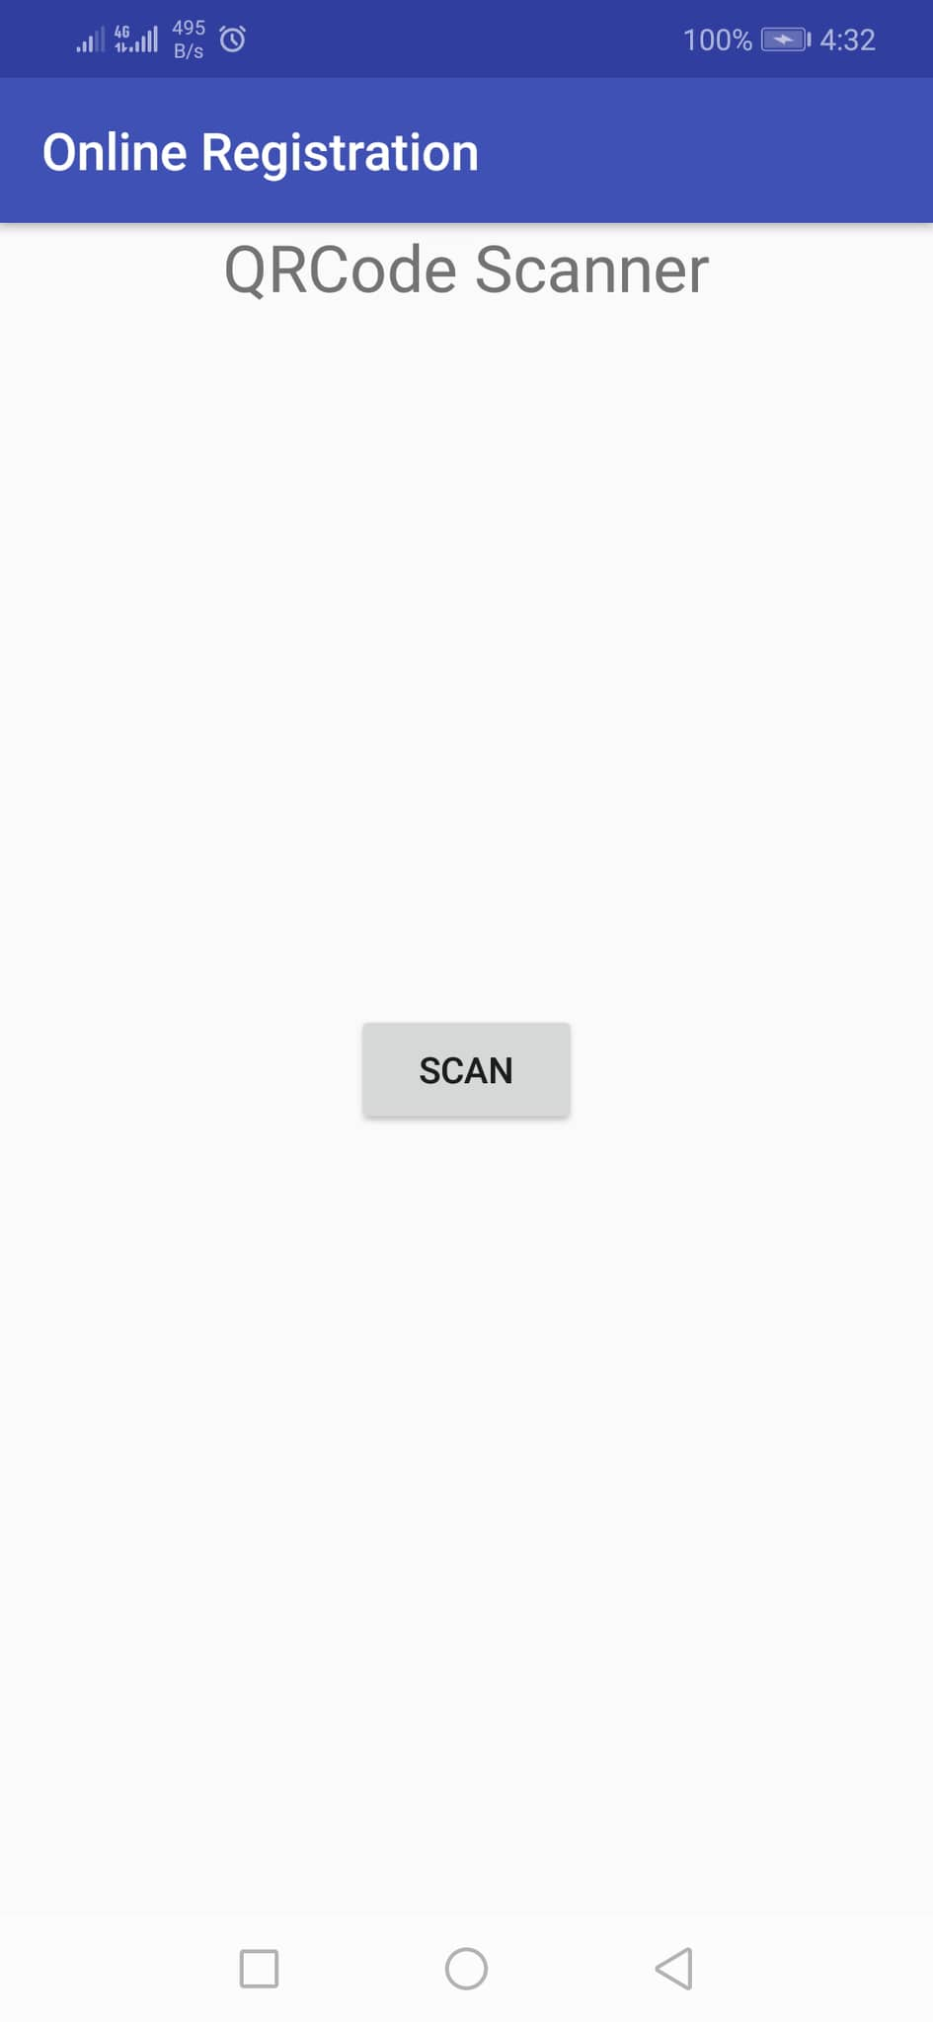
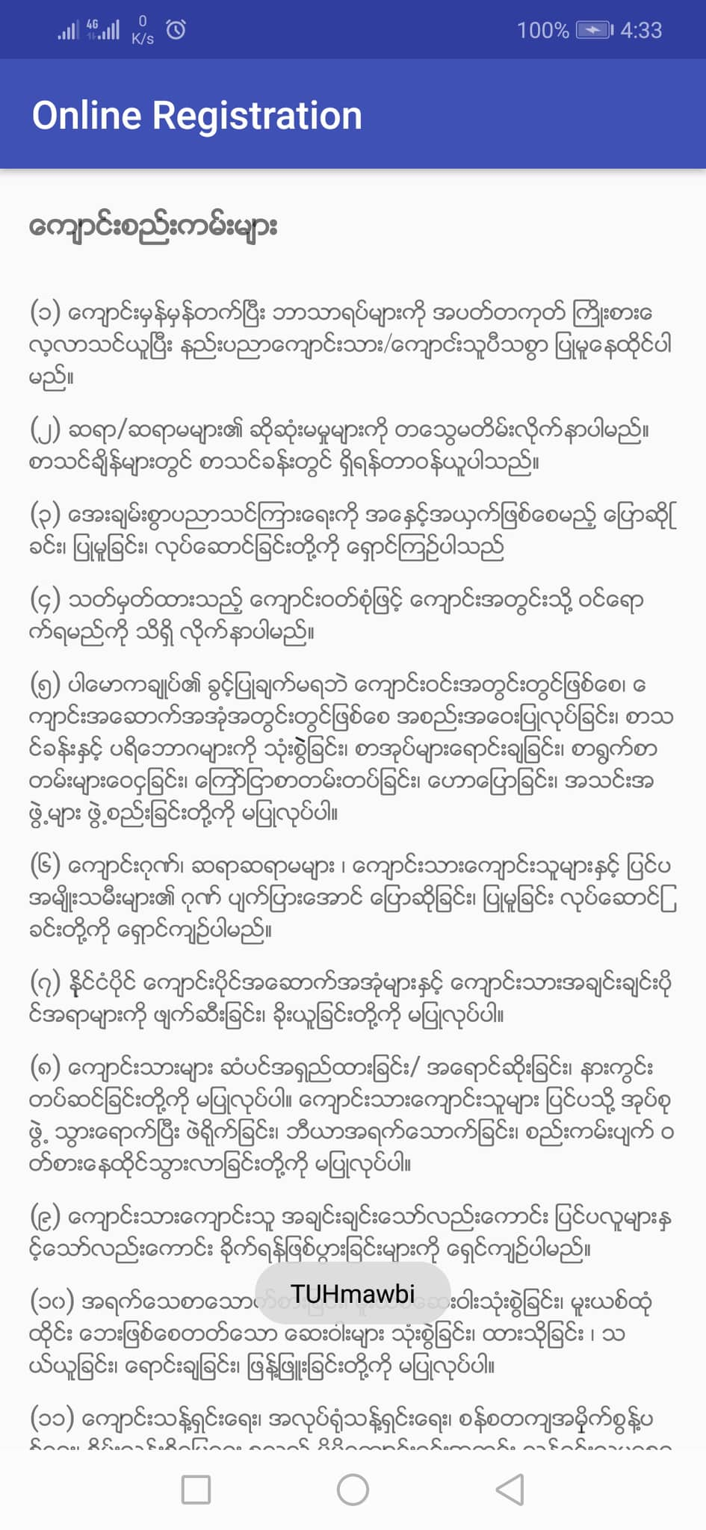

Slide 17
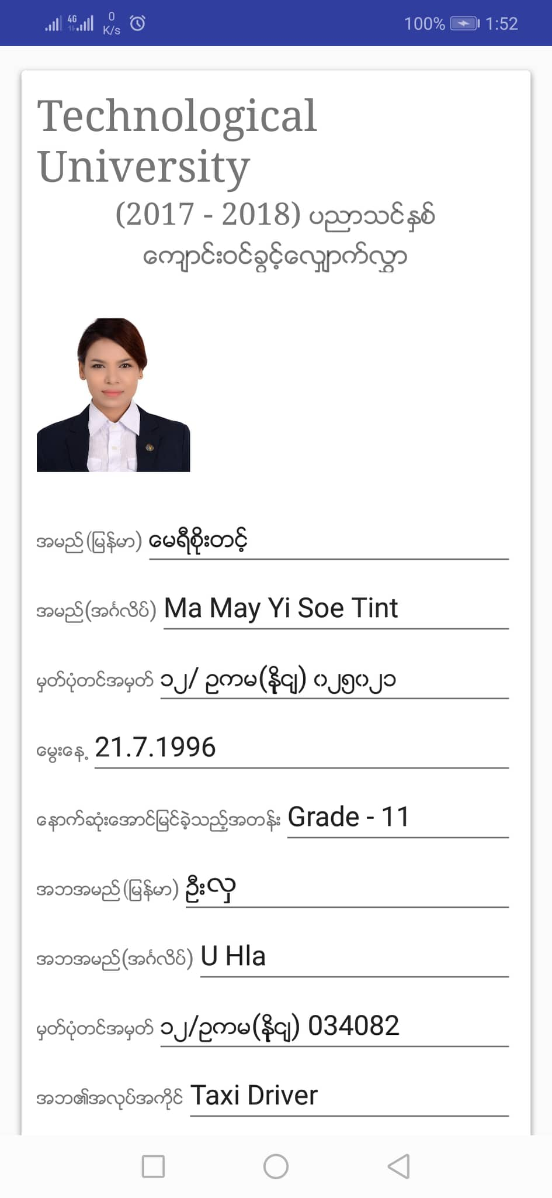
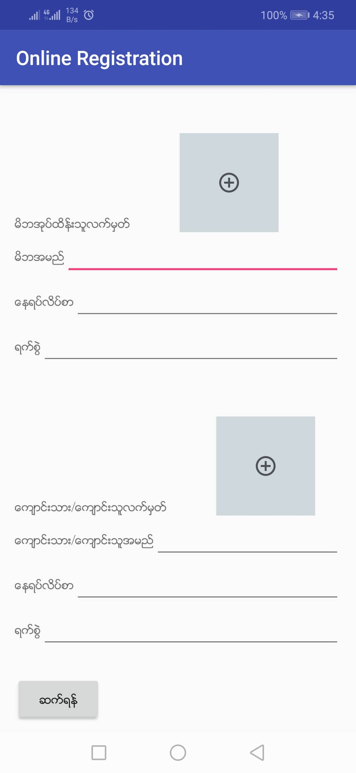

Slide 18
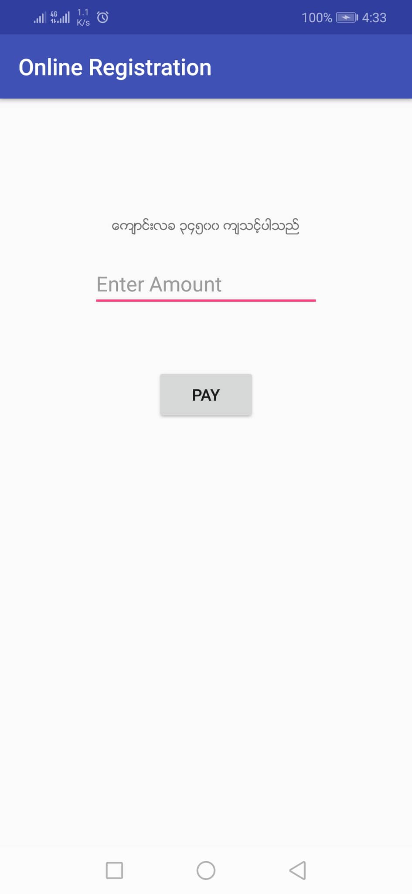
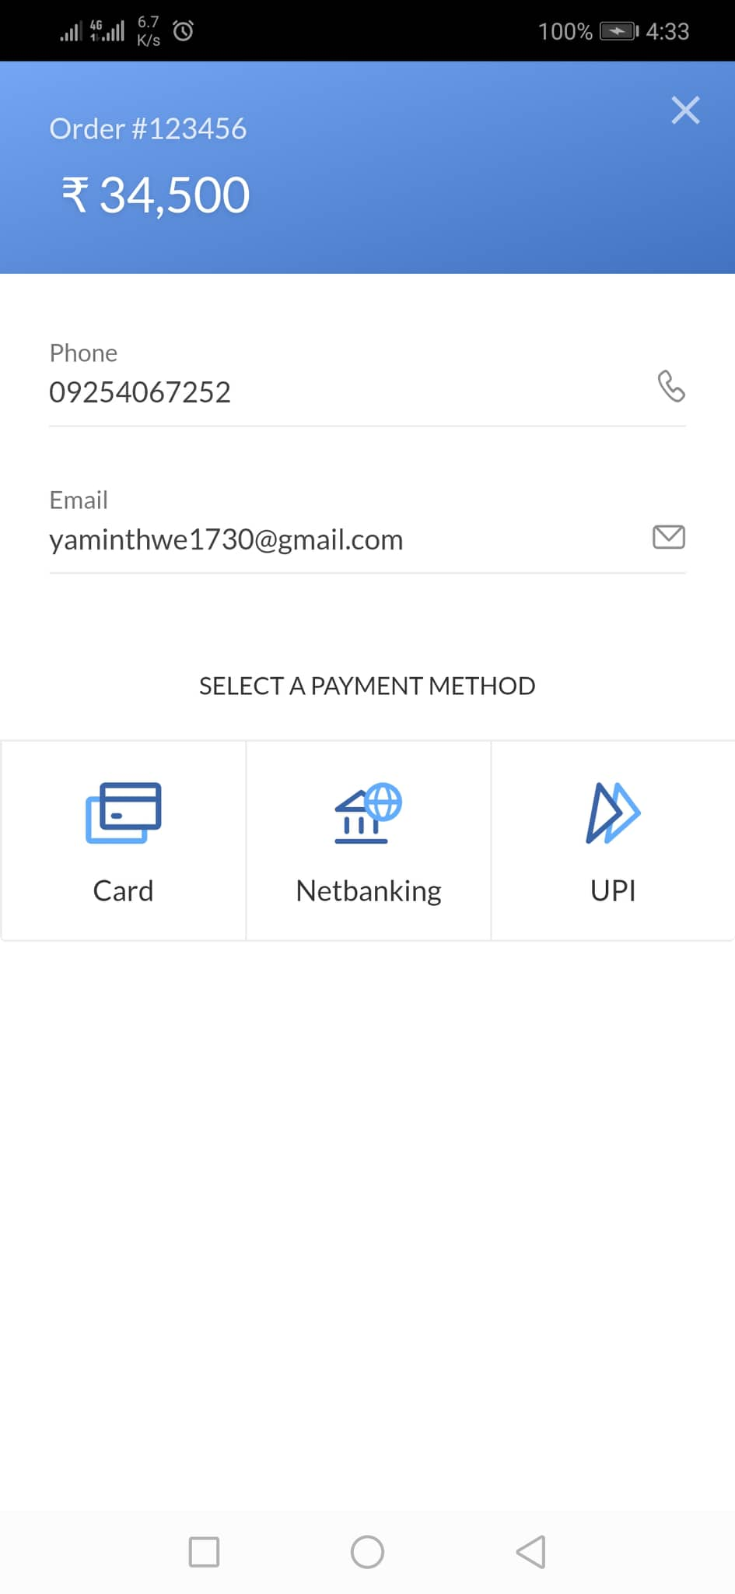

Slide 19
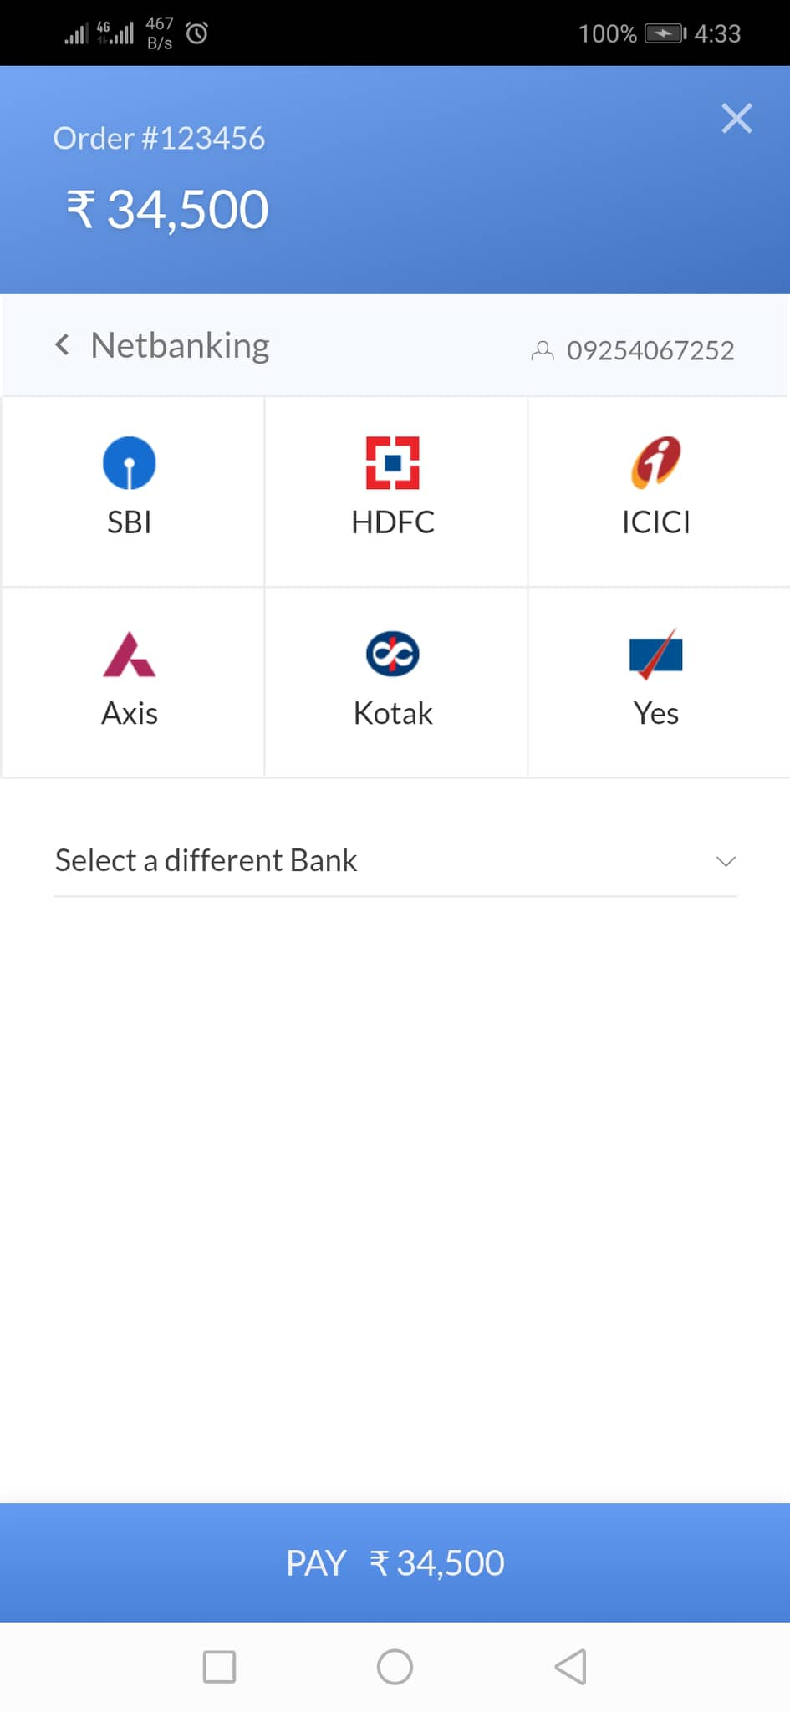
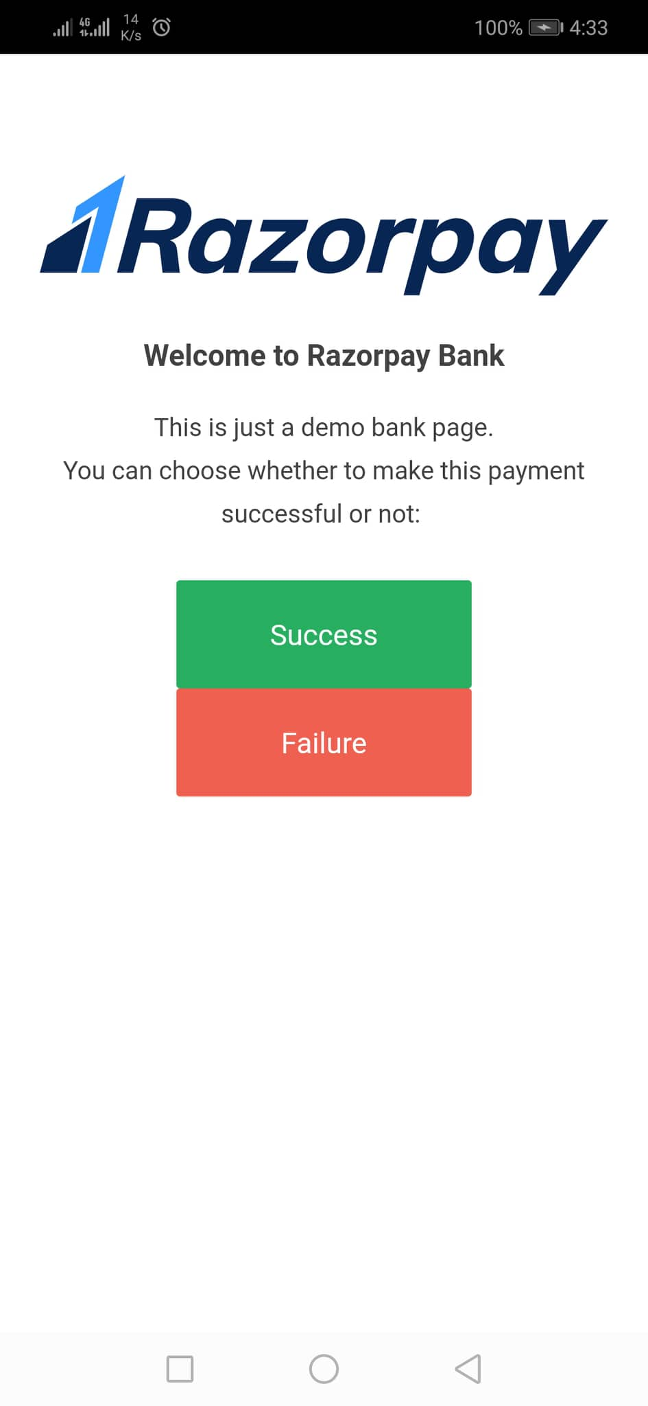

Slide 20
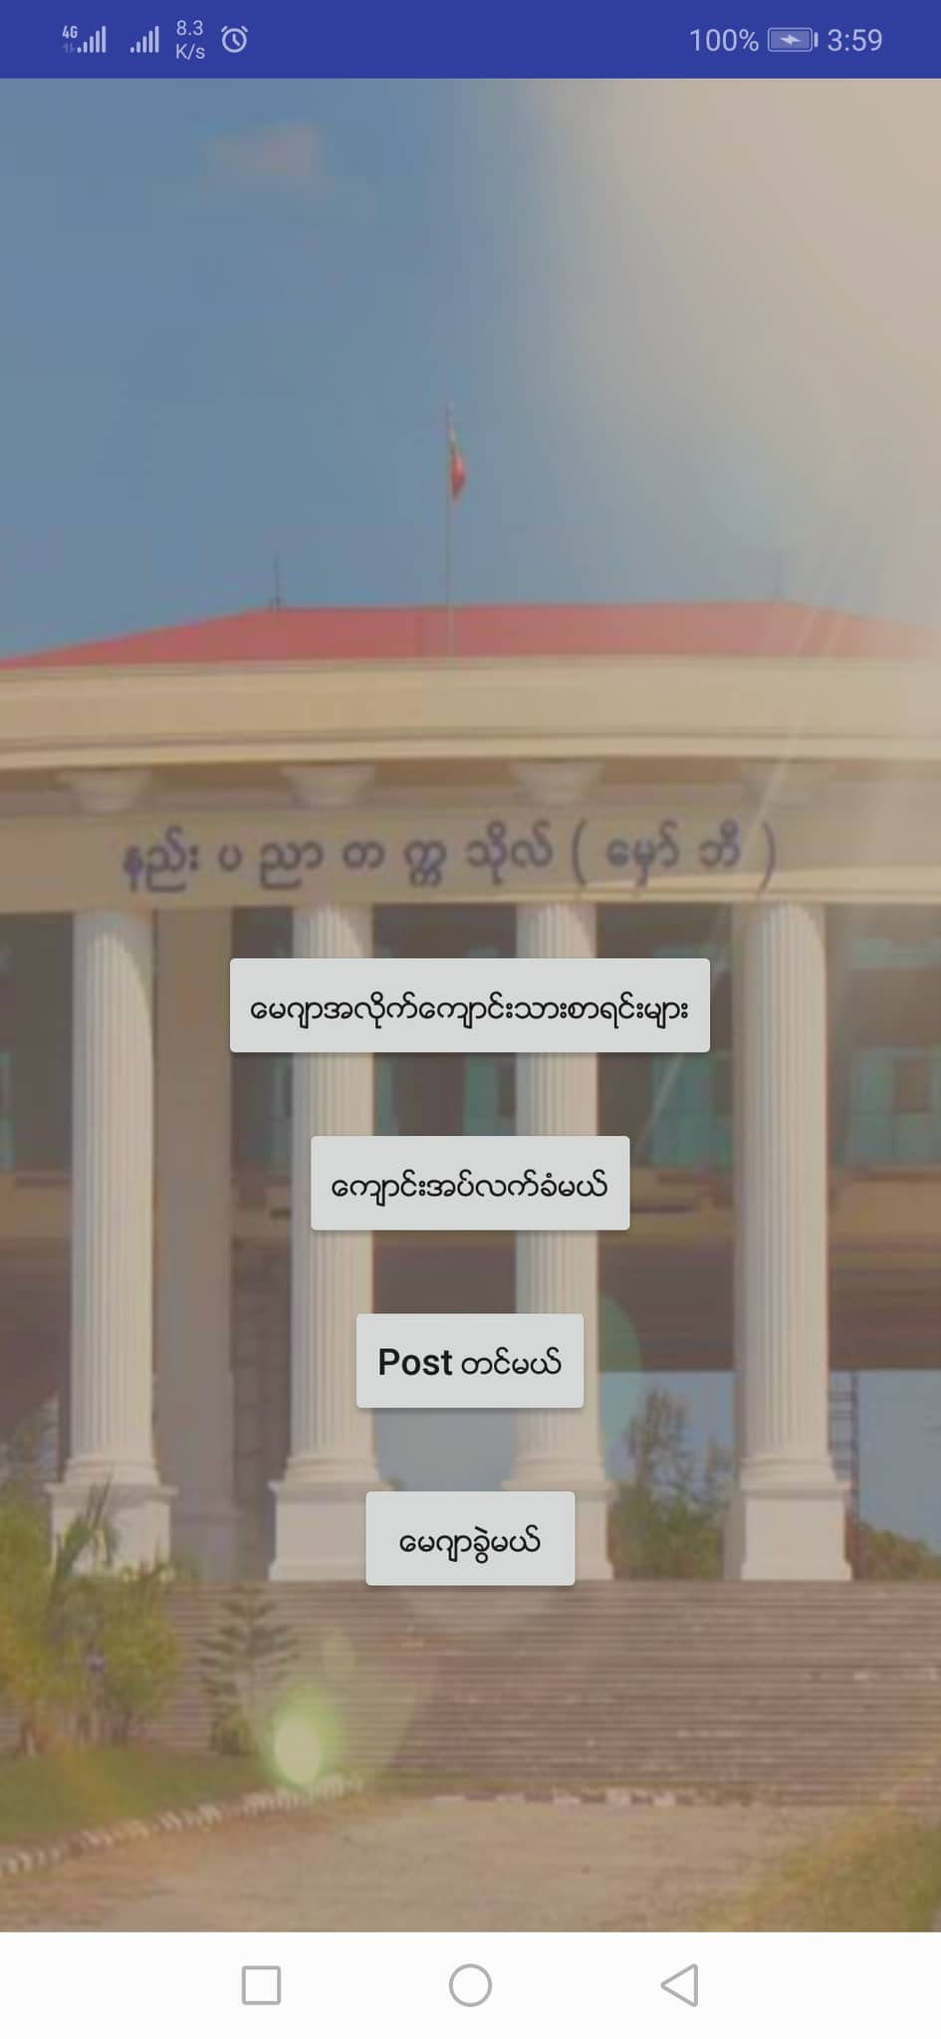
Application Flow(Admin)

Slide 21
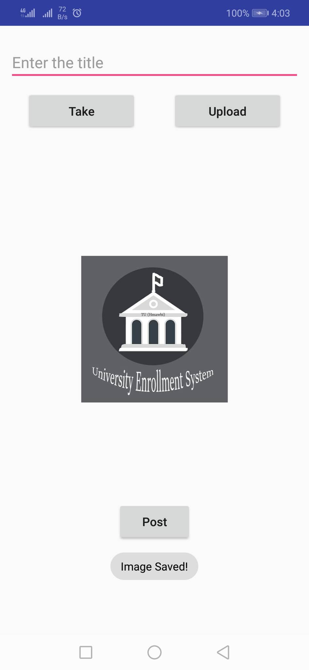
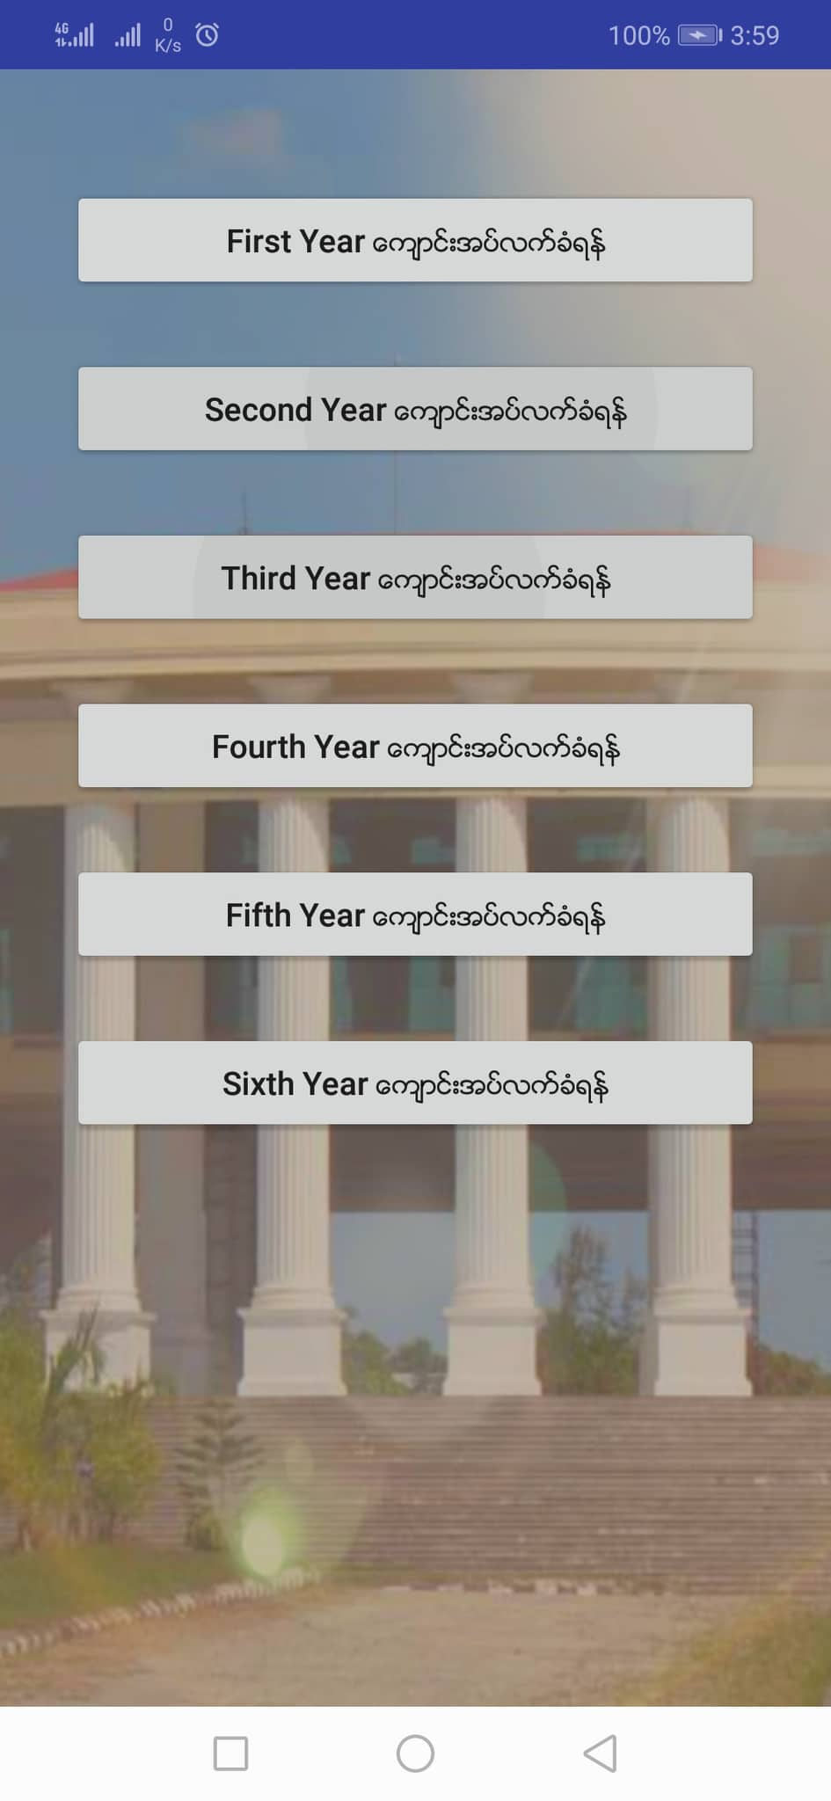

Slide 22
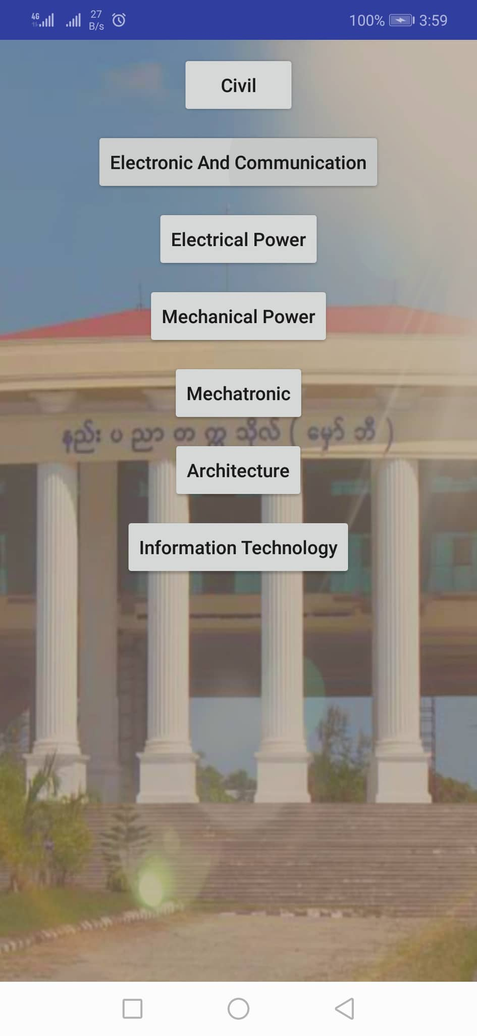
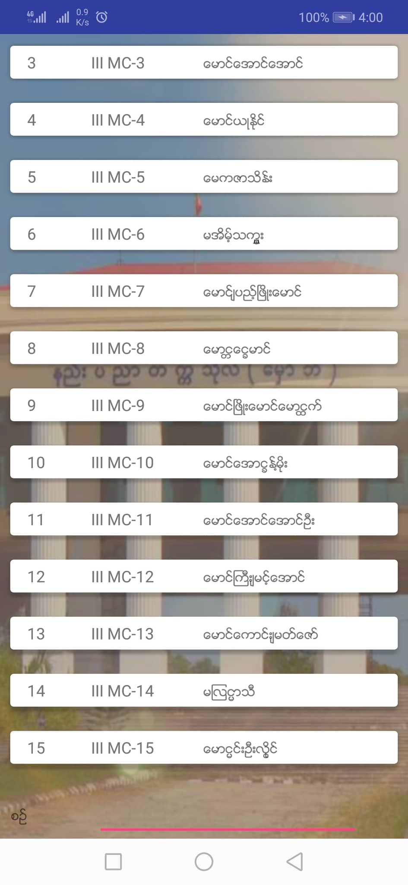

Slide 23
Further Extension
Widely used in various university and college.
Expend other platform;ios and windows.
Can add other features – E library system,Canteen Ordering system,detail about Majors,Technology share and chat room and etc.

Slide 24
Conclusion
The advantages of this application are reduce waste of paper,student’s time,transportation cost.
Disadvantages of this application is hacker can be collect student personal data if system is not secure.

Slide 25
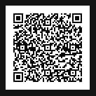

Sharing
Source-(https://github.com/YaminThwe/University_Student_Registration_System_Admin?fbclid=IwAR2H88aSiVSS1ukD7iAlHUfioNBeATFJlj0L8xUXF7rm4CKg0urtxWeHeyM)

Slide 26

Thanks For Your Attention !

